Slide 1
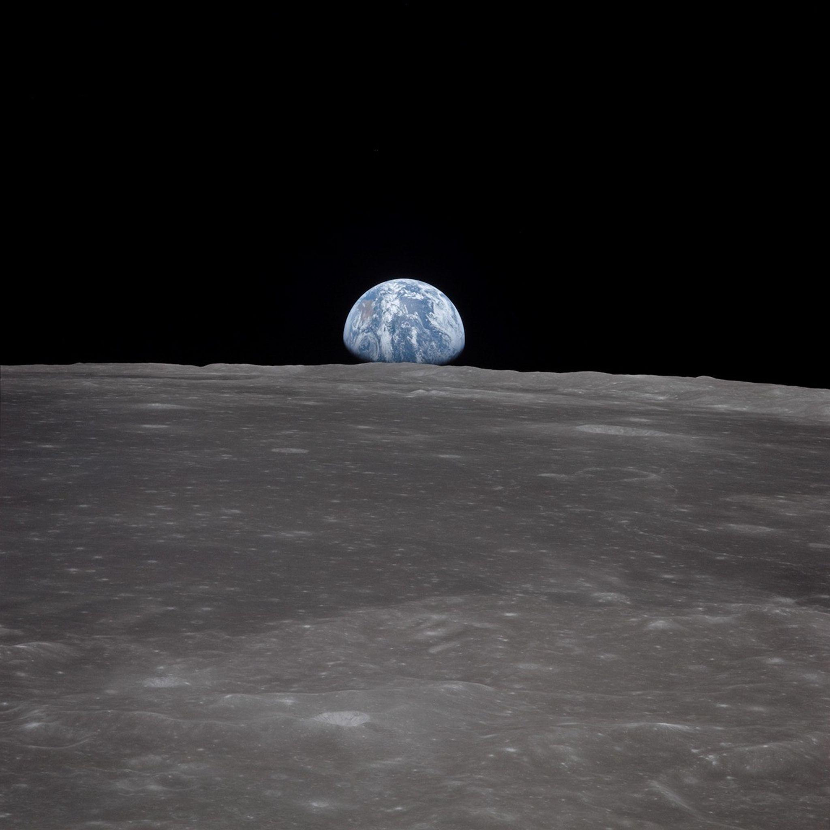

Slide 2



Mednarodna astronomska zveza
Pisarne IAU
za astronomijo v izobraževanju (https://astro4edu.org/)
za astronomijo za razvoj (https://astro4edu.org/)
za ozaveščanje o astronomiji (https://www.iau.org/public/oao/)
NAEC Slovenija:
Andreja Gomboc (andreja.gomboc@ung.si)
Dunja Fabjan (dunja.fabjan@cosmolab.si)
Objave, novice in informacije: Portal v vesolje

Slide 3
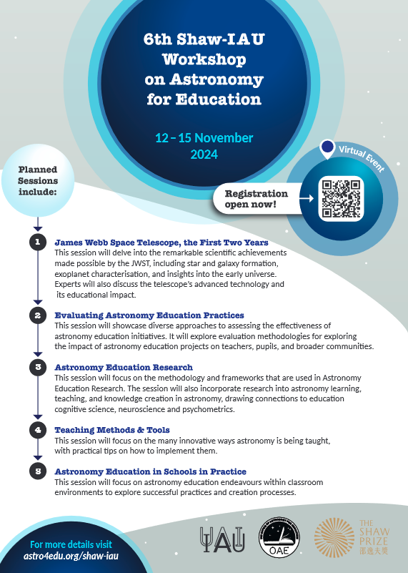
Vabilo: IAU-Shaw srečanje
https://astro4edu.org/shaw-iau/
12-15 November 2024
Special topics:
- exploration of the first two years of the JWST
- the crucial aspect of evaluation in educational contexts
Other sessions:
Astronomy Education Research
Astronomy Education in Practice
Teaching Methods and Tools
Two AstroEDU workshops: In the last 30 min of each workshop participants will be invited in the beta test of the AstroEDU A.I. Assistant.

Slide 4
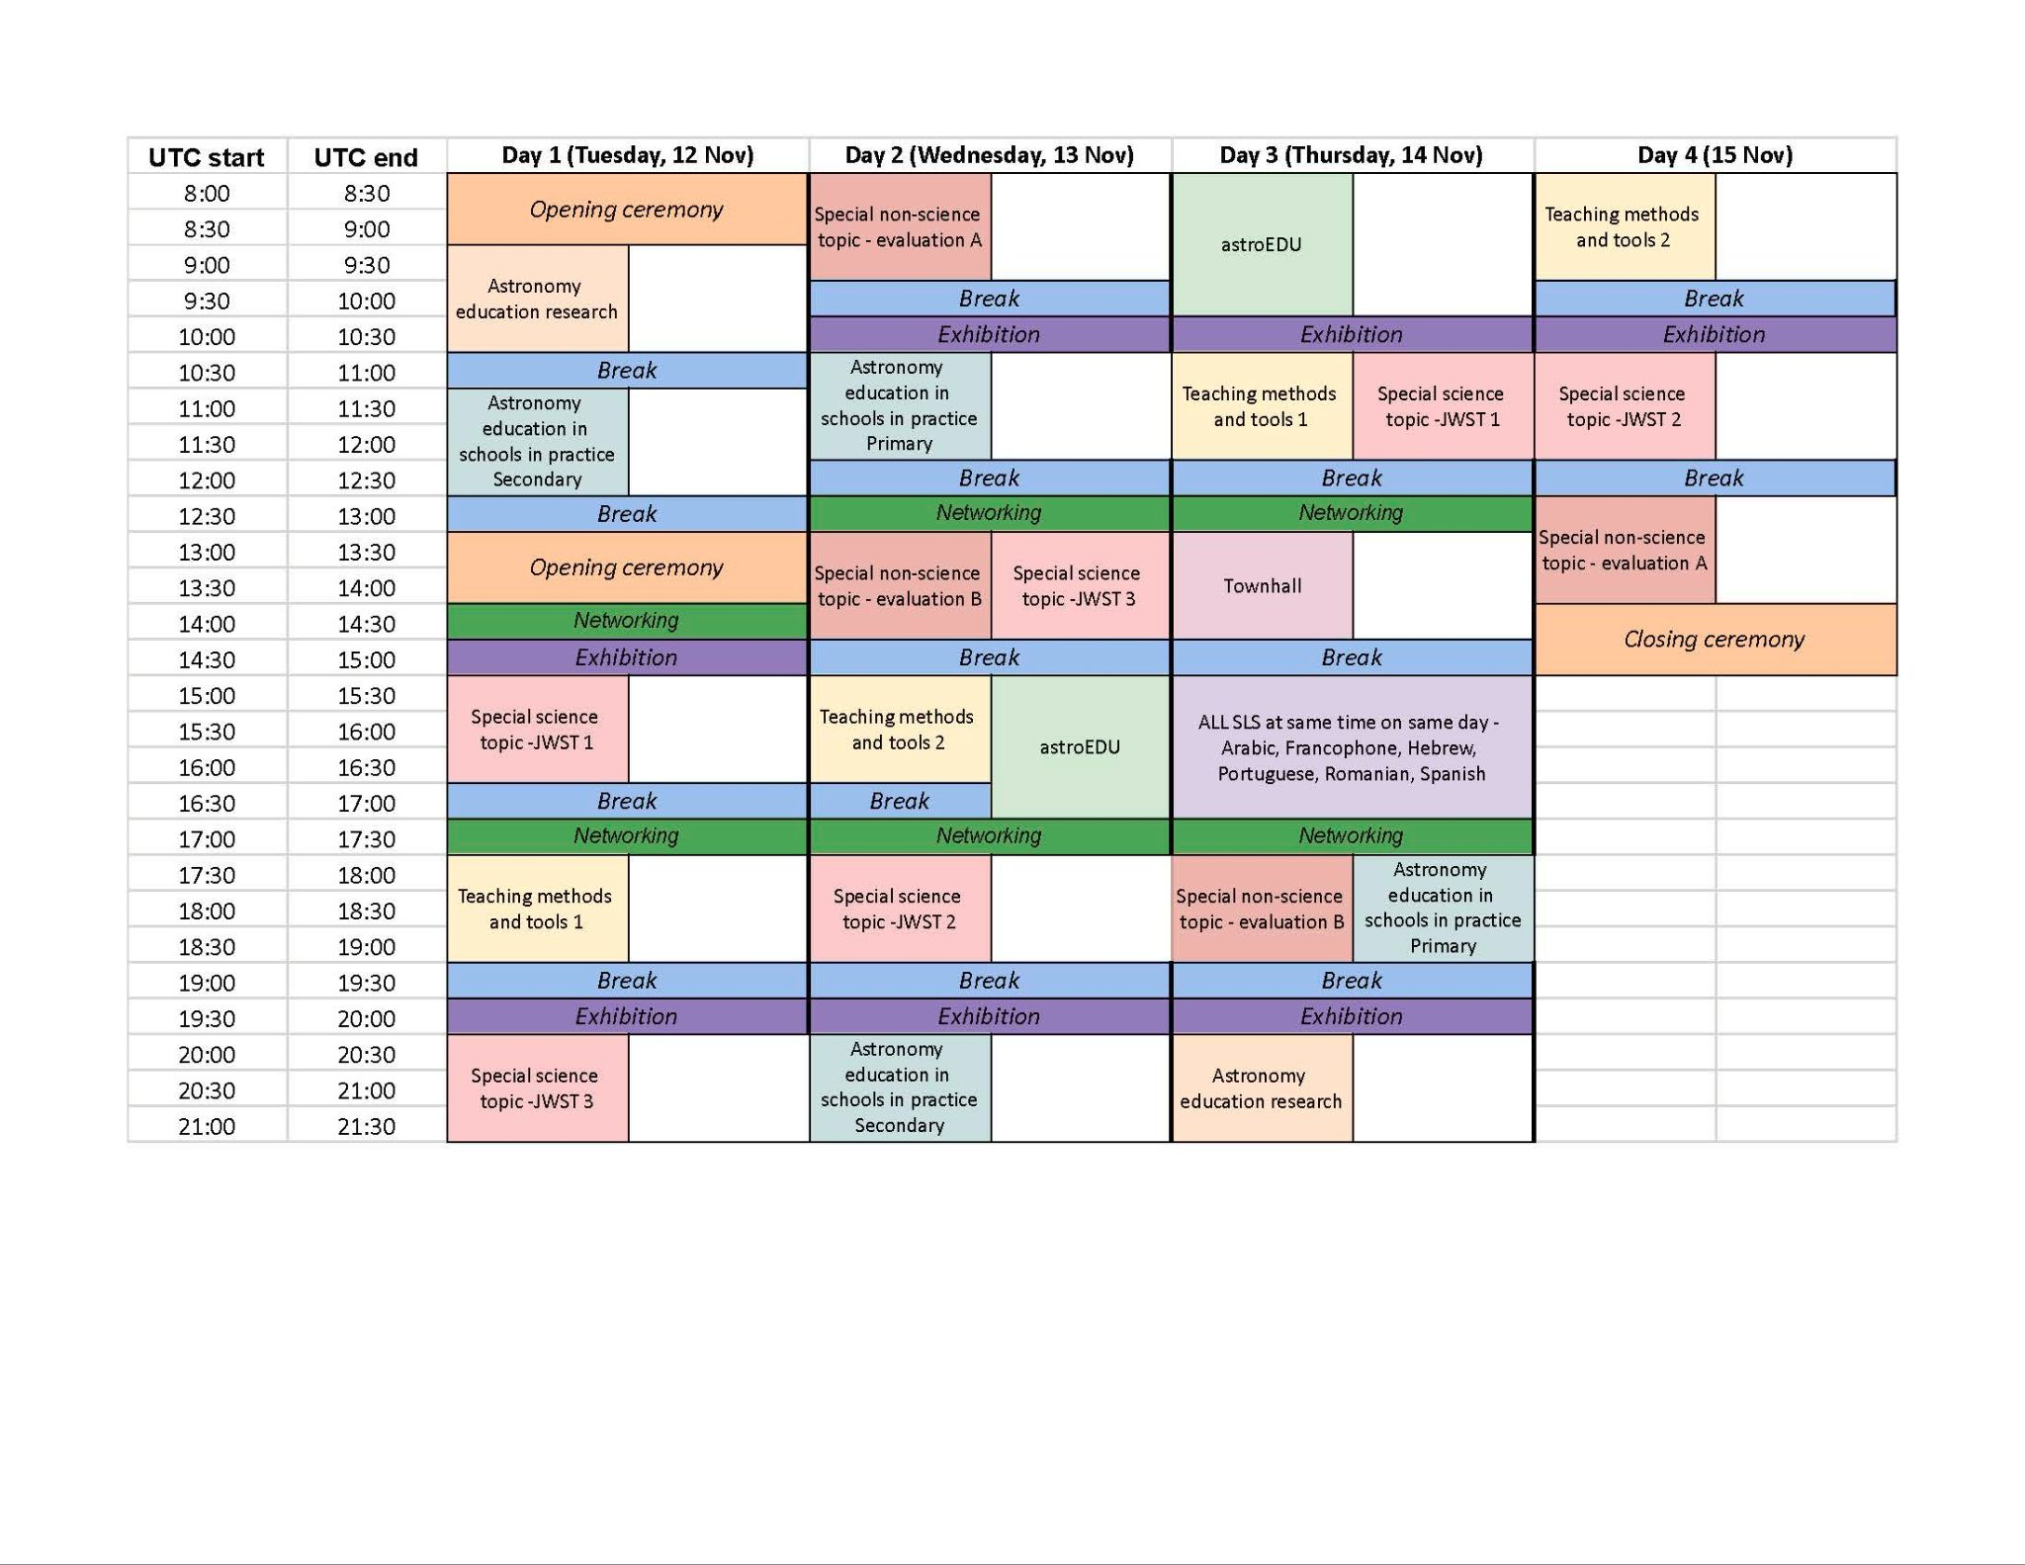

Slide 5
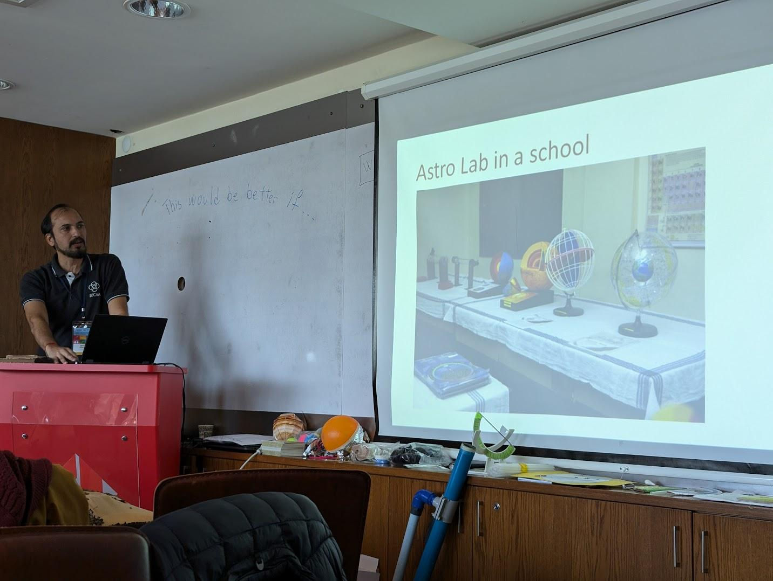
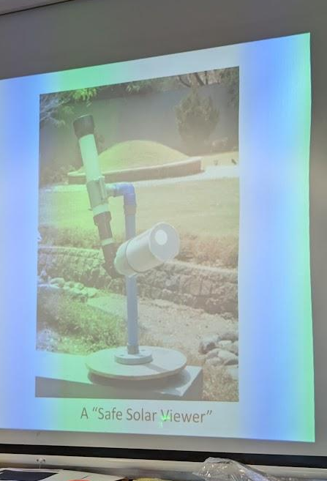
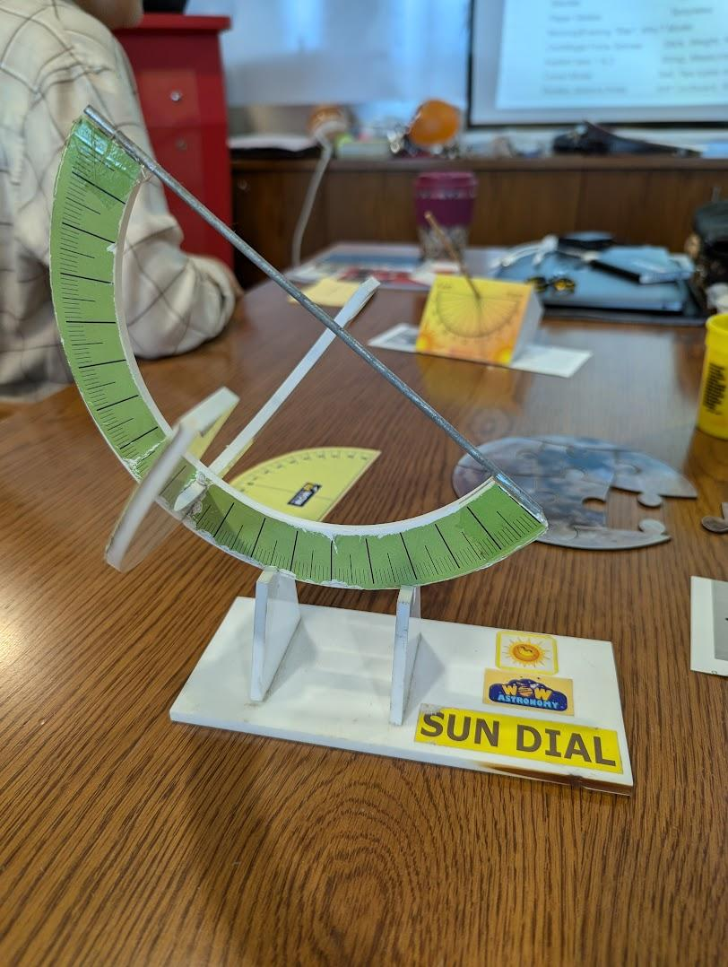
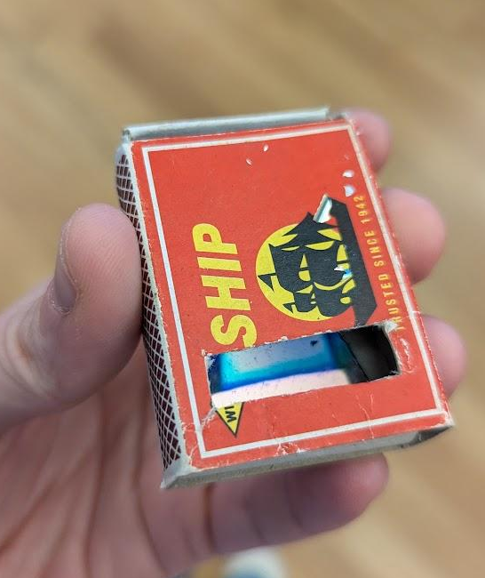
MASTED, Istanbul, oktober 2024
NAEC India (regional coordinator):
Samir Dhurde (samir@iucaa.in)
Šolski astronomski observatorij
Astronomski
pripomočki
iz enostavnega
ali recikliranega
materiala

Slide 7
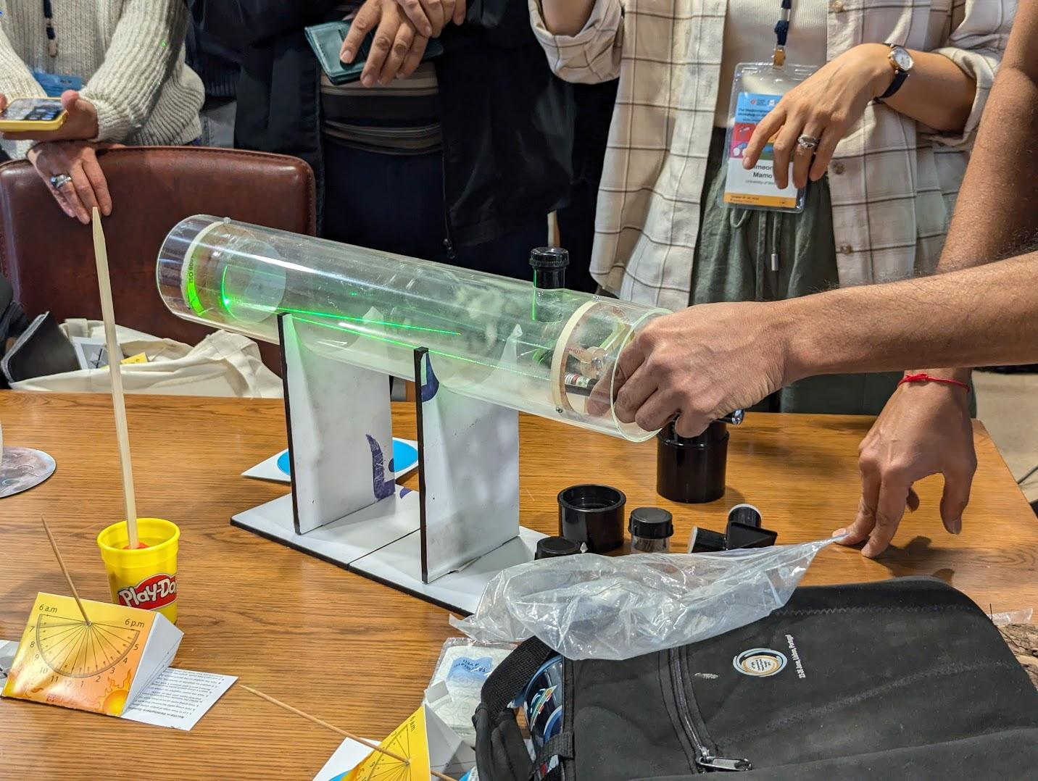

Slide 8
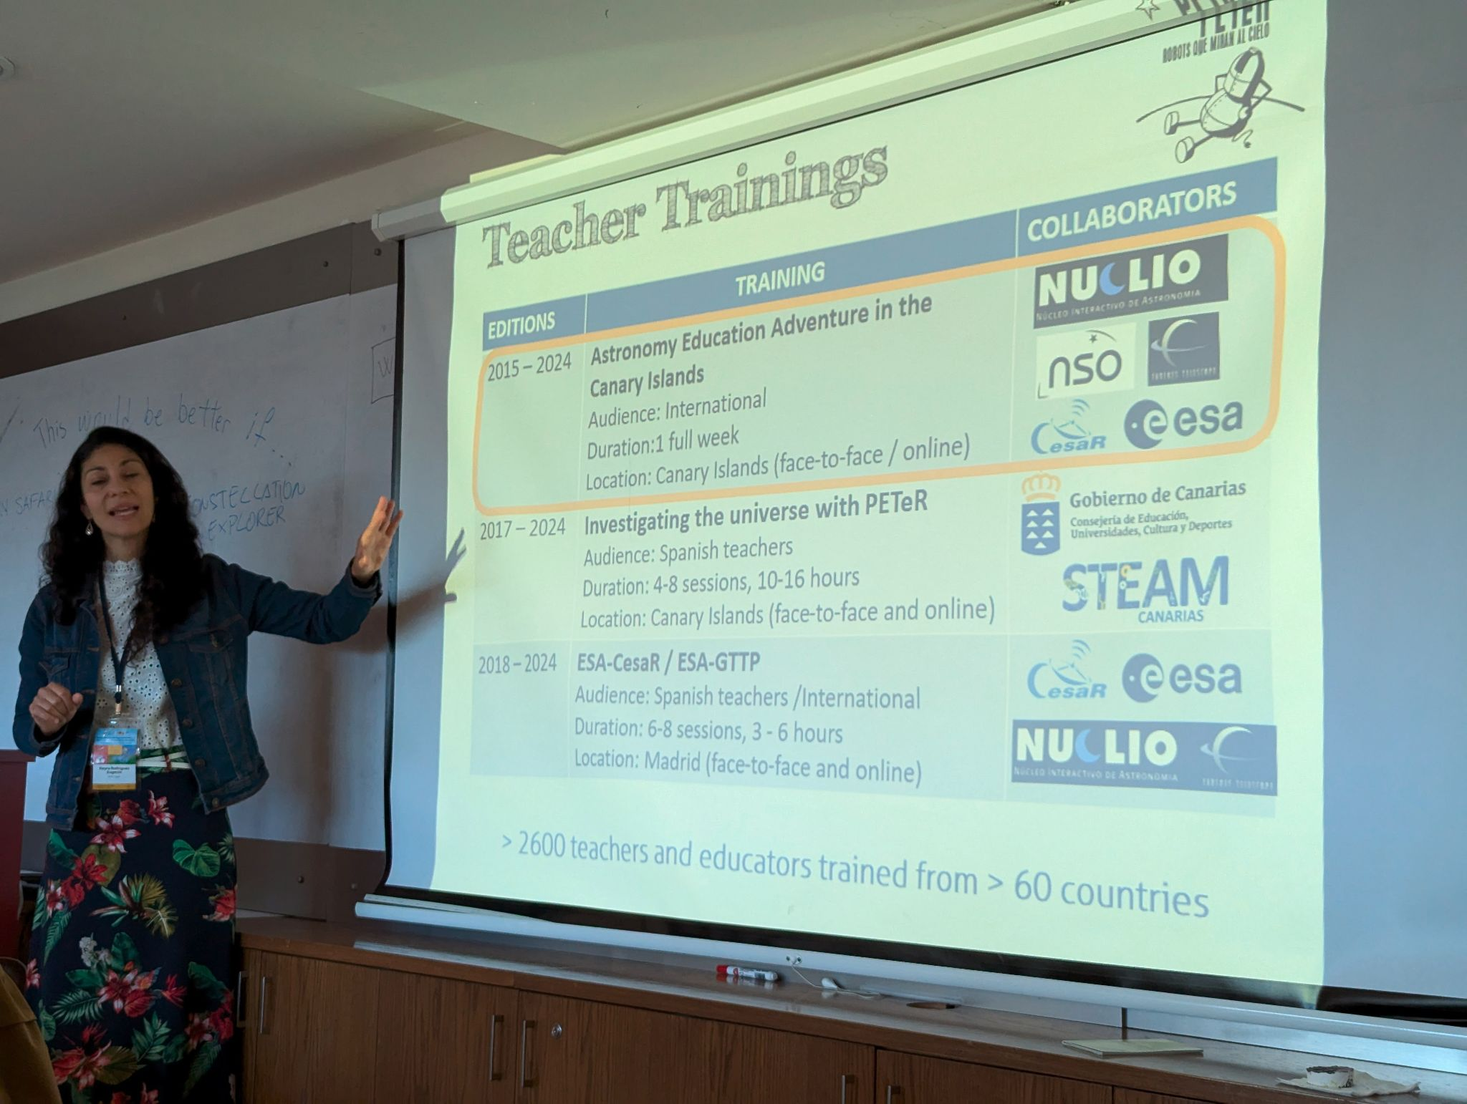
MASTED, Istanbul, oktober 2024
NAEC Spain:
Nayra Rodríguez Eugenio (nre@iac.es)
PETeR - Educational Project
with Robotic Telescopes
https://outreach.iac.es/peter/astronomy-adventures-in-the-canary-islands/aeaci-2024/workshop-investigating-our-place-in-the-universe/
Obrazec za sodelovanje šol iz tujine: https://forms.gle/wBueMYvnPPhHnRtD6

Slide 9
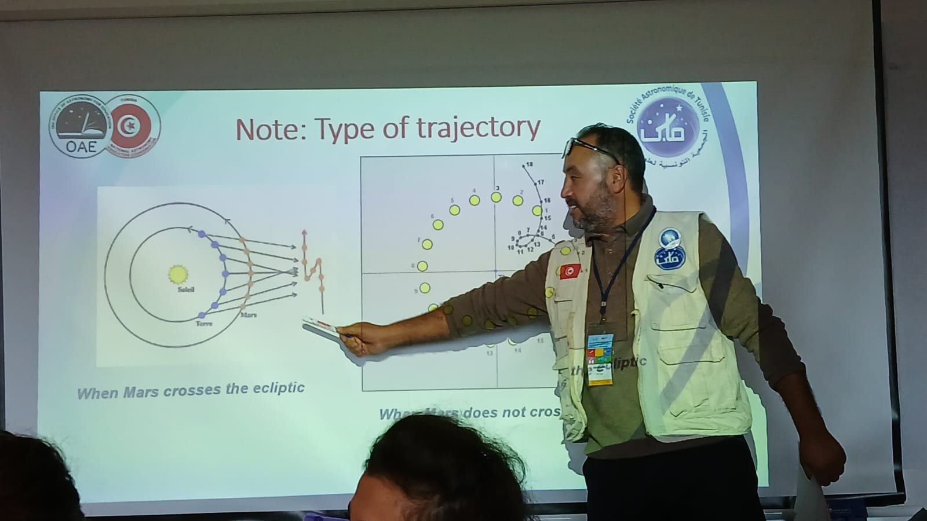
MASTED, Istanbul, oktober 2024
NAEC Tunisia
AbdelHafidh Teyahi
(fstastro@gmail.com)
Retrogradno gibanje Marsa
Dokument na:
https://docs.google.com/document/d/1vy32uOmyZoNjQpCwCkuBFbRKxRGFRE8T/edit

Slide 10
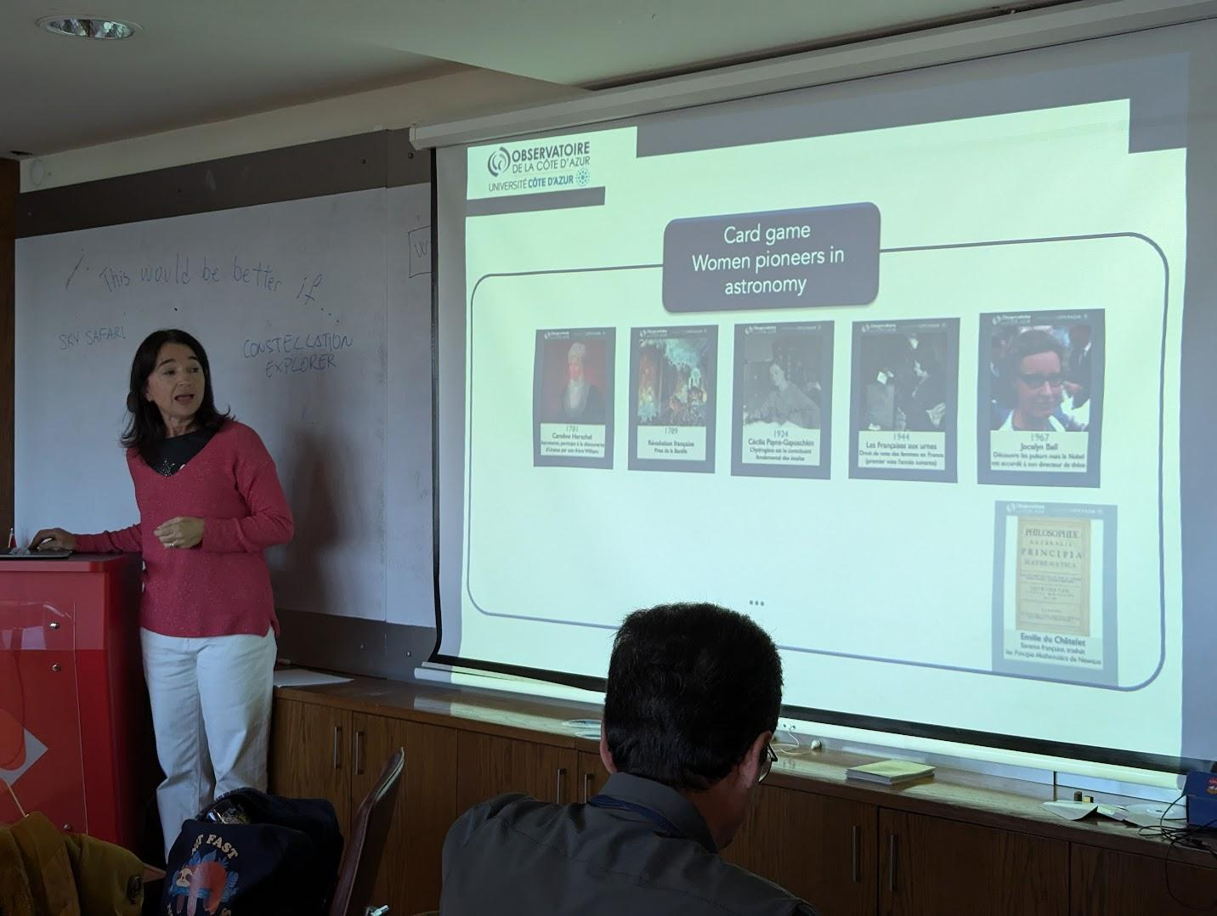
MASTED, Istanbul, oktober 2024
NAEC France
Olga Suarez
(olga.suarez@oca.eu)
Ženske v astronomiji
(igra s kartami)

Slide 11
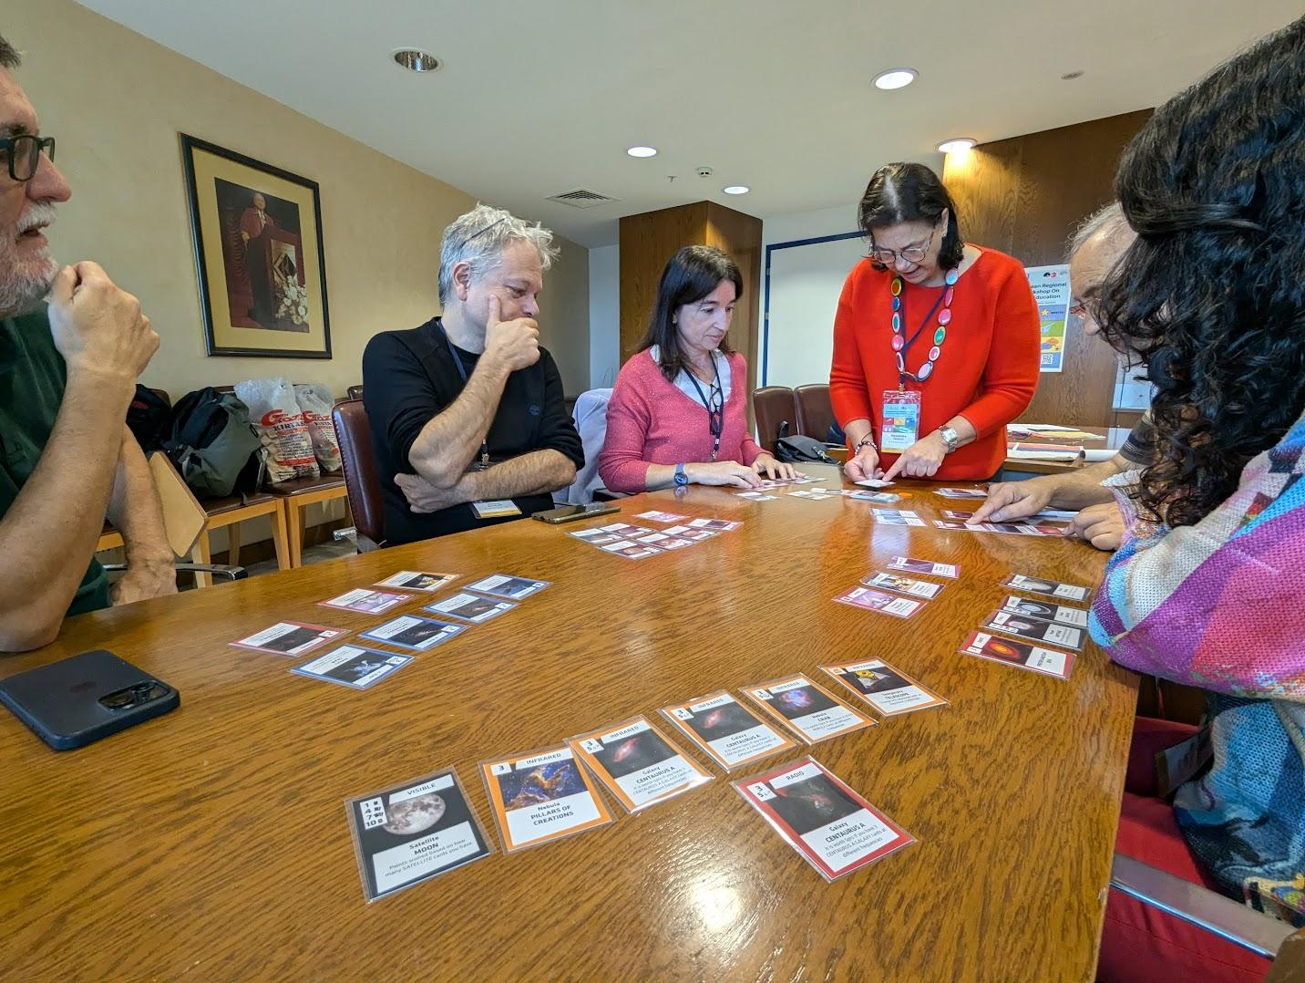

MASTED, Istanbul, oktober 2024
NAEC Italy
Gianandrea Inchingolo
https://www.giannandreainchingolo.com/games

